Slide 1

GageIn Mobile/iPad Beta
February 2013

Slide 2
Guideline
Same as iPhone, no digest email for iPad signup as default
Ensure consistent user experience across iPhone and iPad clients
Almost same features as iPhone; only differences are a) iPad supports Sales Graph, b) UI is slightly different when iPad is held horizontally in company update pages, people updates pages, and company update landing page, and c) most settings are popup
Reference Zite, LinkedIn, Facebook, and Twitter

Slide 3


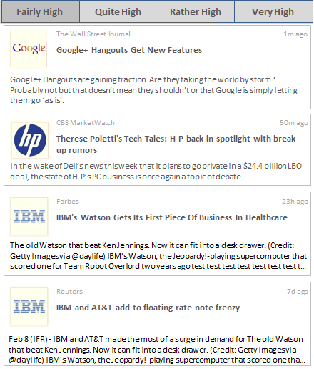





Companies
EXPLORING
Companies
EXPLORING
Relevance:
Funding Development 1m
Growth & Expansions 5d
Mergers & Acquisitions 3d
New Offerings 3d
Personnel Changes 1d
People
Profile
Settings
Don’t display the menu button and open the menu on the left of the update stream automatically and keep as is if the iPad is held horizontally; the update stream is shifted to the right
Use the same design pattern for all companies and people menus

Slide 4


Companies
EXPLORING
Companies
Fairly High
Quite High
Rather High
Very High
Choose Agents
Done
People
The Wall Street Journal 1m ago
Google+ Hangouts Get New Features
+ Add Agent
Profile
Google+ Hangouts are gaining traction. Are they taking the world by storm? Probably not but that doesn’t mean they shouldn’t or that Google is simply letting them go ‘as is’.
CUSTOM AGENTS
Cloud Computing
cloud computing, "big data", SaaS, "...
Settings
CBS MarketWatch 50m ago
Therese Poletti's Tech Tales: H-P back in spotlight with break-up rumors
PREDEFINED AGENTS
Awards & Certifications
Business Challenges
Funding Development
Growth & Expansion
Hiring & Recruiting
Litigations
Mergers & Acquisitions
New Contracts
New Offerings
Partnerships
Personnel Changes
Real Estate Transactions
In the wake of Dell’s news this week that it plans to go private in a $24.4 billion LBO deal, the state of H-P’s PC business is once again a topic of debate.
Forbes 23h ago
IBM's Watson Gets Its First Piece Of Business In Healthcare
The old Watson that beat Ken Jennings. Now it can fit into a desk drawer. (Credit: Getty Images via @daylife) IBM's Watson, the Jeopardy!-playing supercomputer that scored one for Team Robot …
Reuters 7d ago
IBM and AT&T add to floating-rate note frenzy
Feb 8 (IFR) - IBM and AT&T made the most of a surge in demand for The old Watson that beat Ken Jennings. Now it can fit into a desk drawer. (Credit: Getty Images via @daylife) IBM's Watson, the …

Slide 5


Company Update Details
Awards & Certifications
Back
IBM and AT&T add to floating-rate note frenzy
IBM issued US$1bn of two-year notes at three-month Libor minus 2basis points, making it one of the very few corporates to have issued a floater inside of Libor since the credit crisis.
AT&T, meanwhile, issued US$1.25bn of three-year floaters at 38.5bp

Slide 6
Company Update Details
EXPLORING
Back
Company Name
Relevance
Reuters 1h ago
IBM and AT&T add to floating-rate note frenzy
IBM and AT&T add to floating-rate note frenzy
Reuters 7h ago
IBM and AT&T add to floating-rate note frenzy
Reuters 1d ago
IBM and AT&T add to floating-rate note frenzy
Don’t display the upward and downward arrows and instead display the corresponding update stream and keep as is if the iPad is held horizontally; the update content is shifted to the right
IBM issued US$1bn of two-year notes at three-month Libor minus 2basis points, making it one of the very few corporates to have issued a floater inside of Libor since the credit crisis.
AT&T, meanwhile, issued US$1.25bn of three-year floaters at 38.5bp

